Slide 1
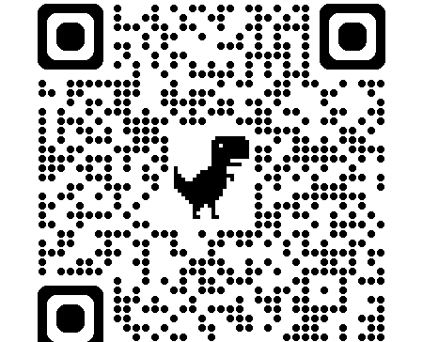
Course Website
113-2
Natural Language Processing and Applications
https://github.com/mcps5601/CGUNLP_2025_Spring

Slide 2


人工智慧在自然語言處理與應用 Artificial Intelligence in Natural Language Processing and Applications
Course Introduction
Slido
# 1466691 (Link)
Instructor: 林英嘉 (Ying-Jia Lin)
2025/02/17

Slide 3
自然語言處理與應用 Natural Language Processing and Applications
Course Introduction
Slido
# 1466691 (Link)
Instructor: 林英嘉 (Ying-Jia Lin)
2025/02/17

Slide 4




About Me
Experience and Education (Time)
Assistant Professor | Department of Artificial Intelligence, Chang Gung University (2025/02 - )
Postdoctoral Researcher | Department of Computer Science, National Tsing Hua University (2024/09 - 2025/01)
Ph.D. | Department of Computer Science and Information Engineering, National Cheng Kung University (2019/08 - 2024/02)
M.S. | Institute of Biomedical Informatics, National Yang-Ming University (2017/09 - 2019/07)
B.S. | Department of Biomedical Sciences, Chang Gung University (2013/09 - 2017/06)
🪖

Slide 5
Outline
Introduction to Artificial Intelligence and Natural Language Processing
History of Artificial Intelligence
Course Introduction and requirements

Slide 6

Venn Diagram about AI, ML, and DL
Machine Learning (ML)
Deep Learning (DL)
Ex. Logistic Regression
Ex. 專家系統 (Expert system; Knowledge base)
Ex. Multi-layer Perceptron
NLP
Artificial Intelligence (AI)

Slide 7
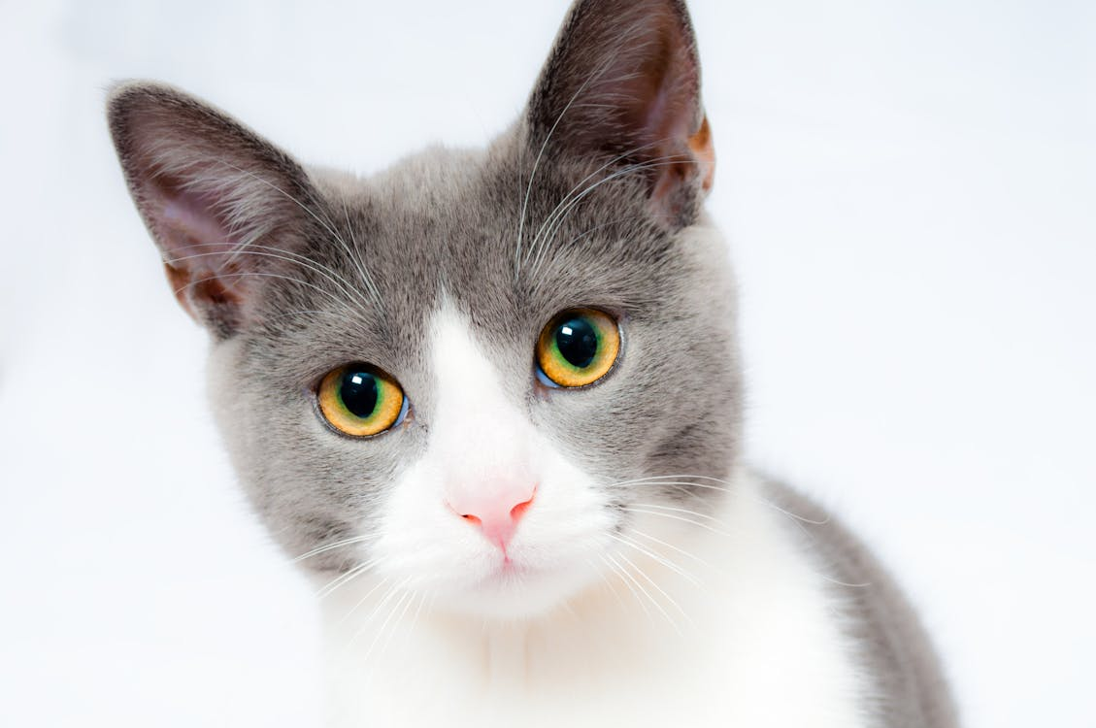

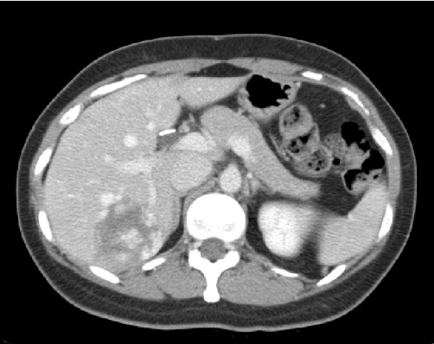
What is Deep Learning?
We start the concepts from machine learning.
Machine Learning function!
Cat
Classifier
Dog
Apple
Classifier
Malignant
Benign

Slide 8
How about DL in Natural Language Processing?
Sentiment Analysis (IMDb dataset ^{[1]})
This movie was awful. The ending was absolutely horrible.
Classifier
Positive
Negative
Translation, EN-ZH (WMT-19 dataset ^{[2]})
Machine Translation Model
Yet not nearly enough has been invested in this effort.
但目前這方面的投入還遠遠不夠。
[1] https://huggingface.co/datasets/stanfordnlp/imdb
[2] https://huggingface.co/datasets/wmt/wmt19/viewer/zh-en

Slide 9
Common NLP tasks
Text Classification
Text Generation
Sequence Tagging
Text Matching
Sentiment Analysis
Machine Translation
Part-of-speech tagging
Semantic Textual Similarity
Natural Language Inference (NLI)
Summarization
Named Entity Recognition (NER)
Retrieval
Dialogue Generation
Word Segmentation

Slide 10
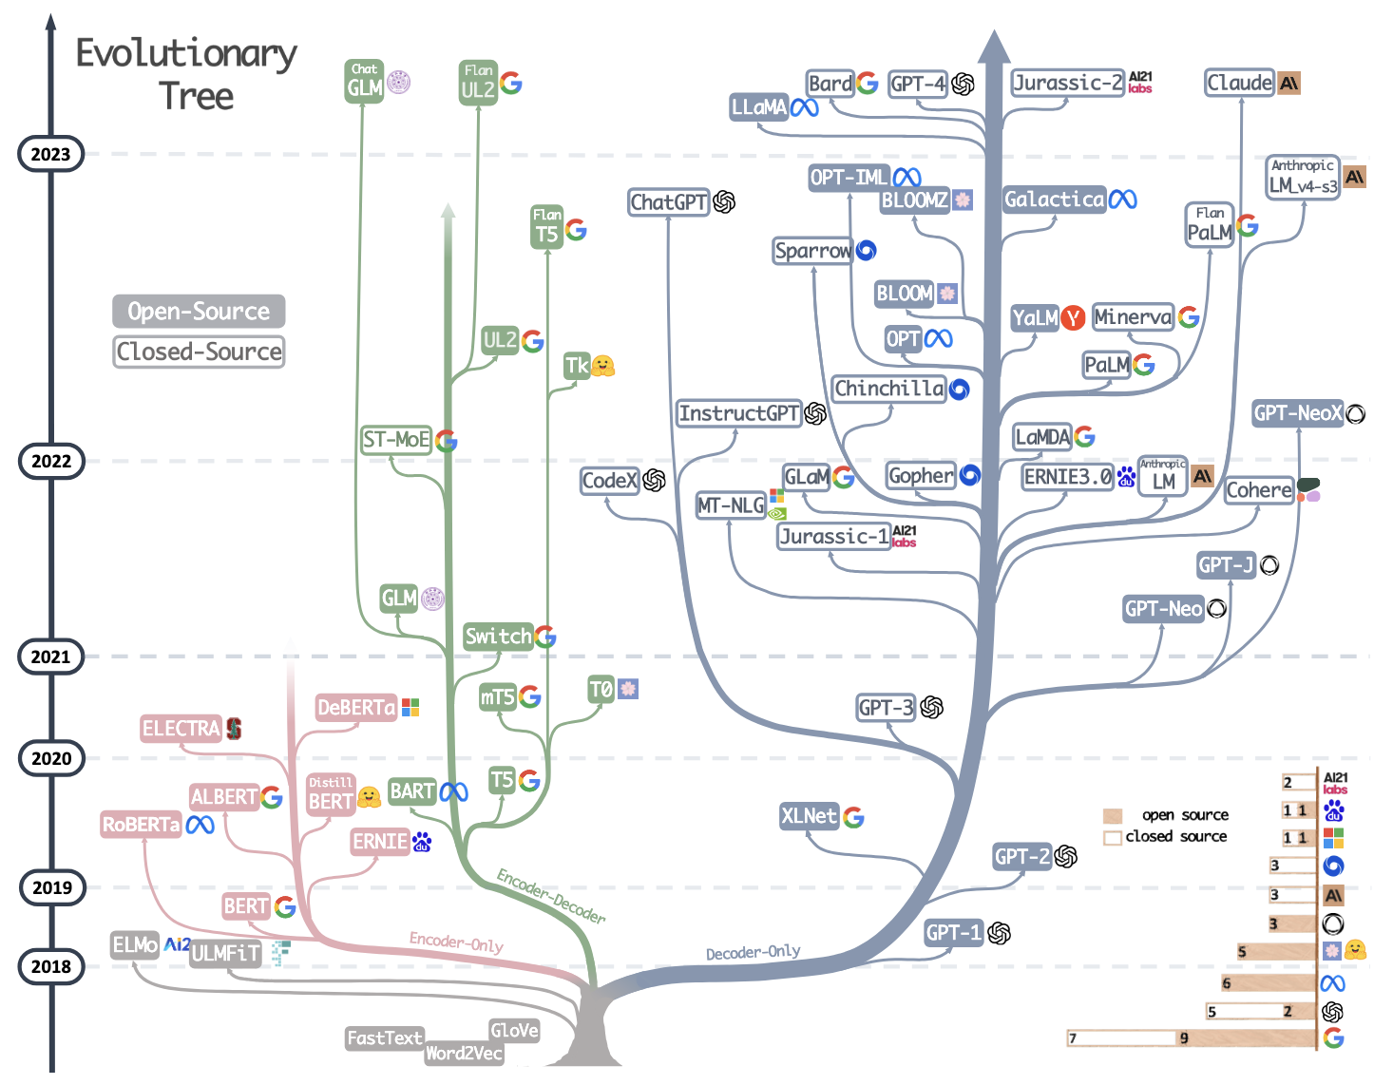
Evolutionary Tree of Large Language Models
Yang, Jingfeng, et al. "Harnessing the power of llms in practice: A survey on chatgpt and beyond." ACM Transactions on Knowledge Discovery from Data 18.6 (2024): 1-32.

Slide 11
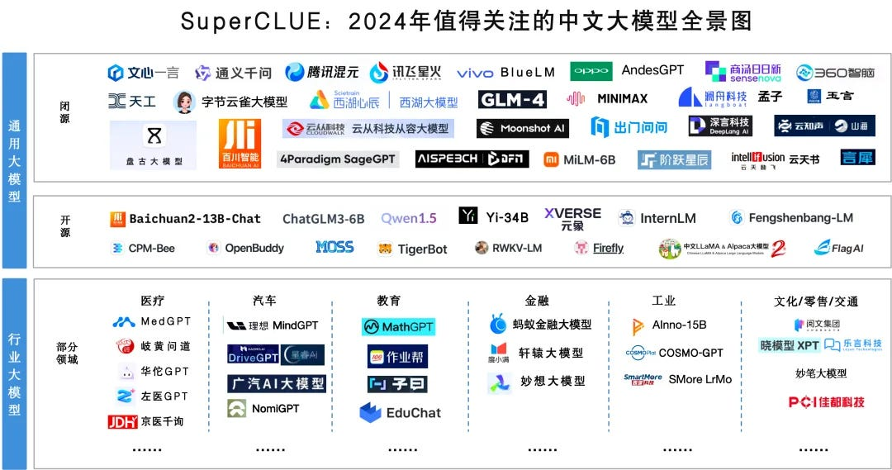
Chinese LLMs
Figure source: https://chinai.substack.com/p/chinai-264-superclue-april-2024-report

Slide 12
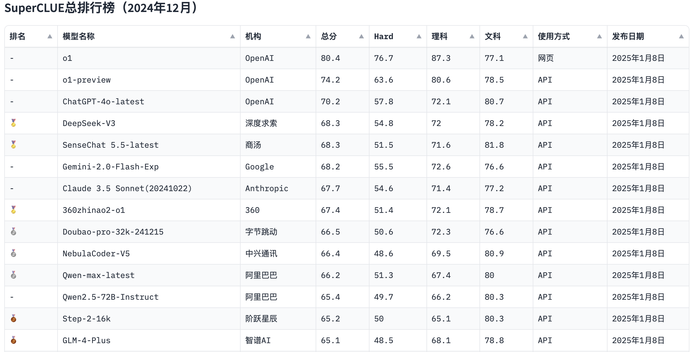
SuperCLUE Leaderboard
Figure source: https://www.superclueai.com/

Slide 13
電腦是如何學習自然語言呢？

Slide 14
Word Representations
like
🖥️
?
apple
Basic Approach
apple
[1, 0, 0, 0, 0, 0, 0, 0]
One hot encodings with each vector size equal to the vocab size (8 in this case)
Corpus
eat
[0, 1, 0, 0, 0, 0, 0, 0]
I like to eat apple
I
[0, 0, 1, 0, 0, 0, 0, 0]
Vocabulary
Pros: handy, training-free
Cons: sparse matrix which occupies much memory
You like to watch TV
like
[0, 0, 0, 1, 0, 0, 0, 0]
watch
[0, 0, 0, 0, 1, 0, 0, 0]
to
[0, 0, 0, 0, 0, 1, 0, 0]
...

Slide 15

Word Embeddings (Word2Vec)
Input
Word2Vec model
Prediction
[1] Mikolov et al. "Distributed representations of words and phrases and their compositionality." NeurIPS 2013.
Steve
Jobs
CBOW ^{[1]}
(Continuous Bag-of-Words)
[MASK]
founded
Apple
Large Corpora
(E.g., Wikipedia)
Inc.
[MASK]
Steve
[MASK]
Jobs
Skip-gram ^{[1]}
founded
[MASK]
Apple
[MASK]
Inc.

Slide 16
After Training Word Embeddings
The outputs are dense vectors with a fixed dimension size:
Dimension size (e.g., 300)
apple -0.110960 0.016115 -0.004809 0.033589 0.121455 …
banana -0.027713 -0.015676 0.003314 0.077602 0.159718 …
…
…
…
Vocabulary size
(e.g., 30,000)

Slide 17
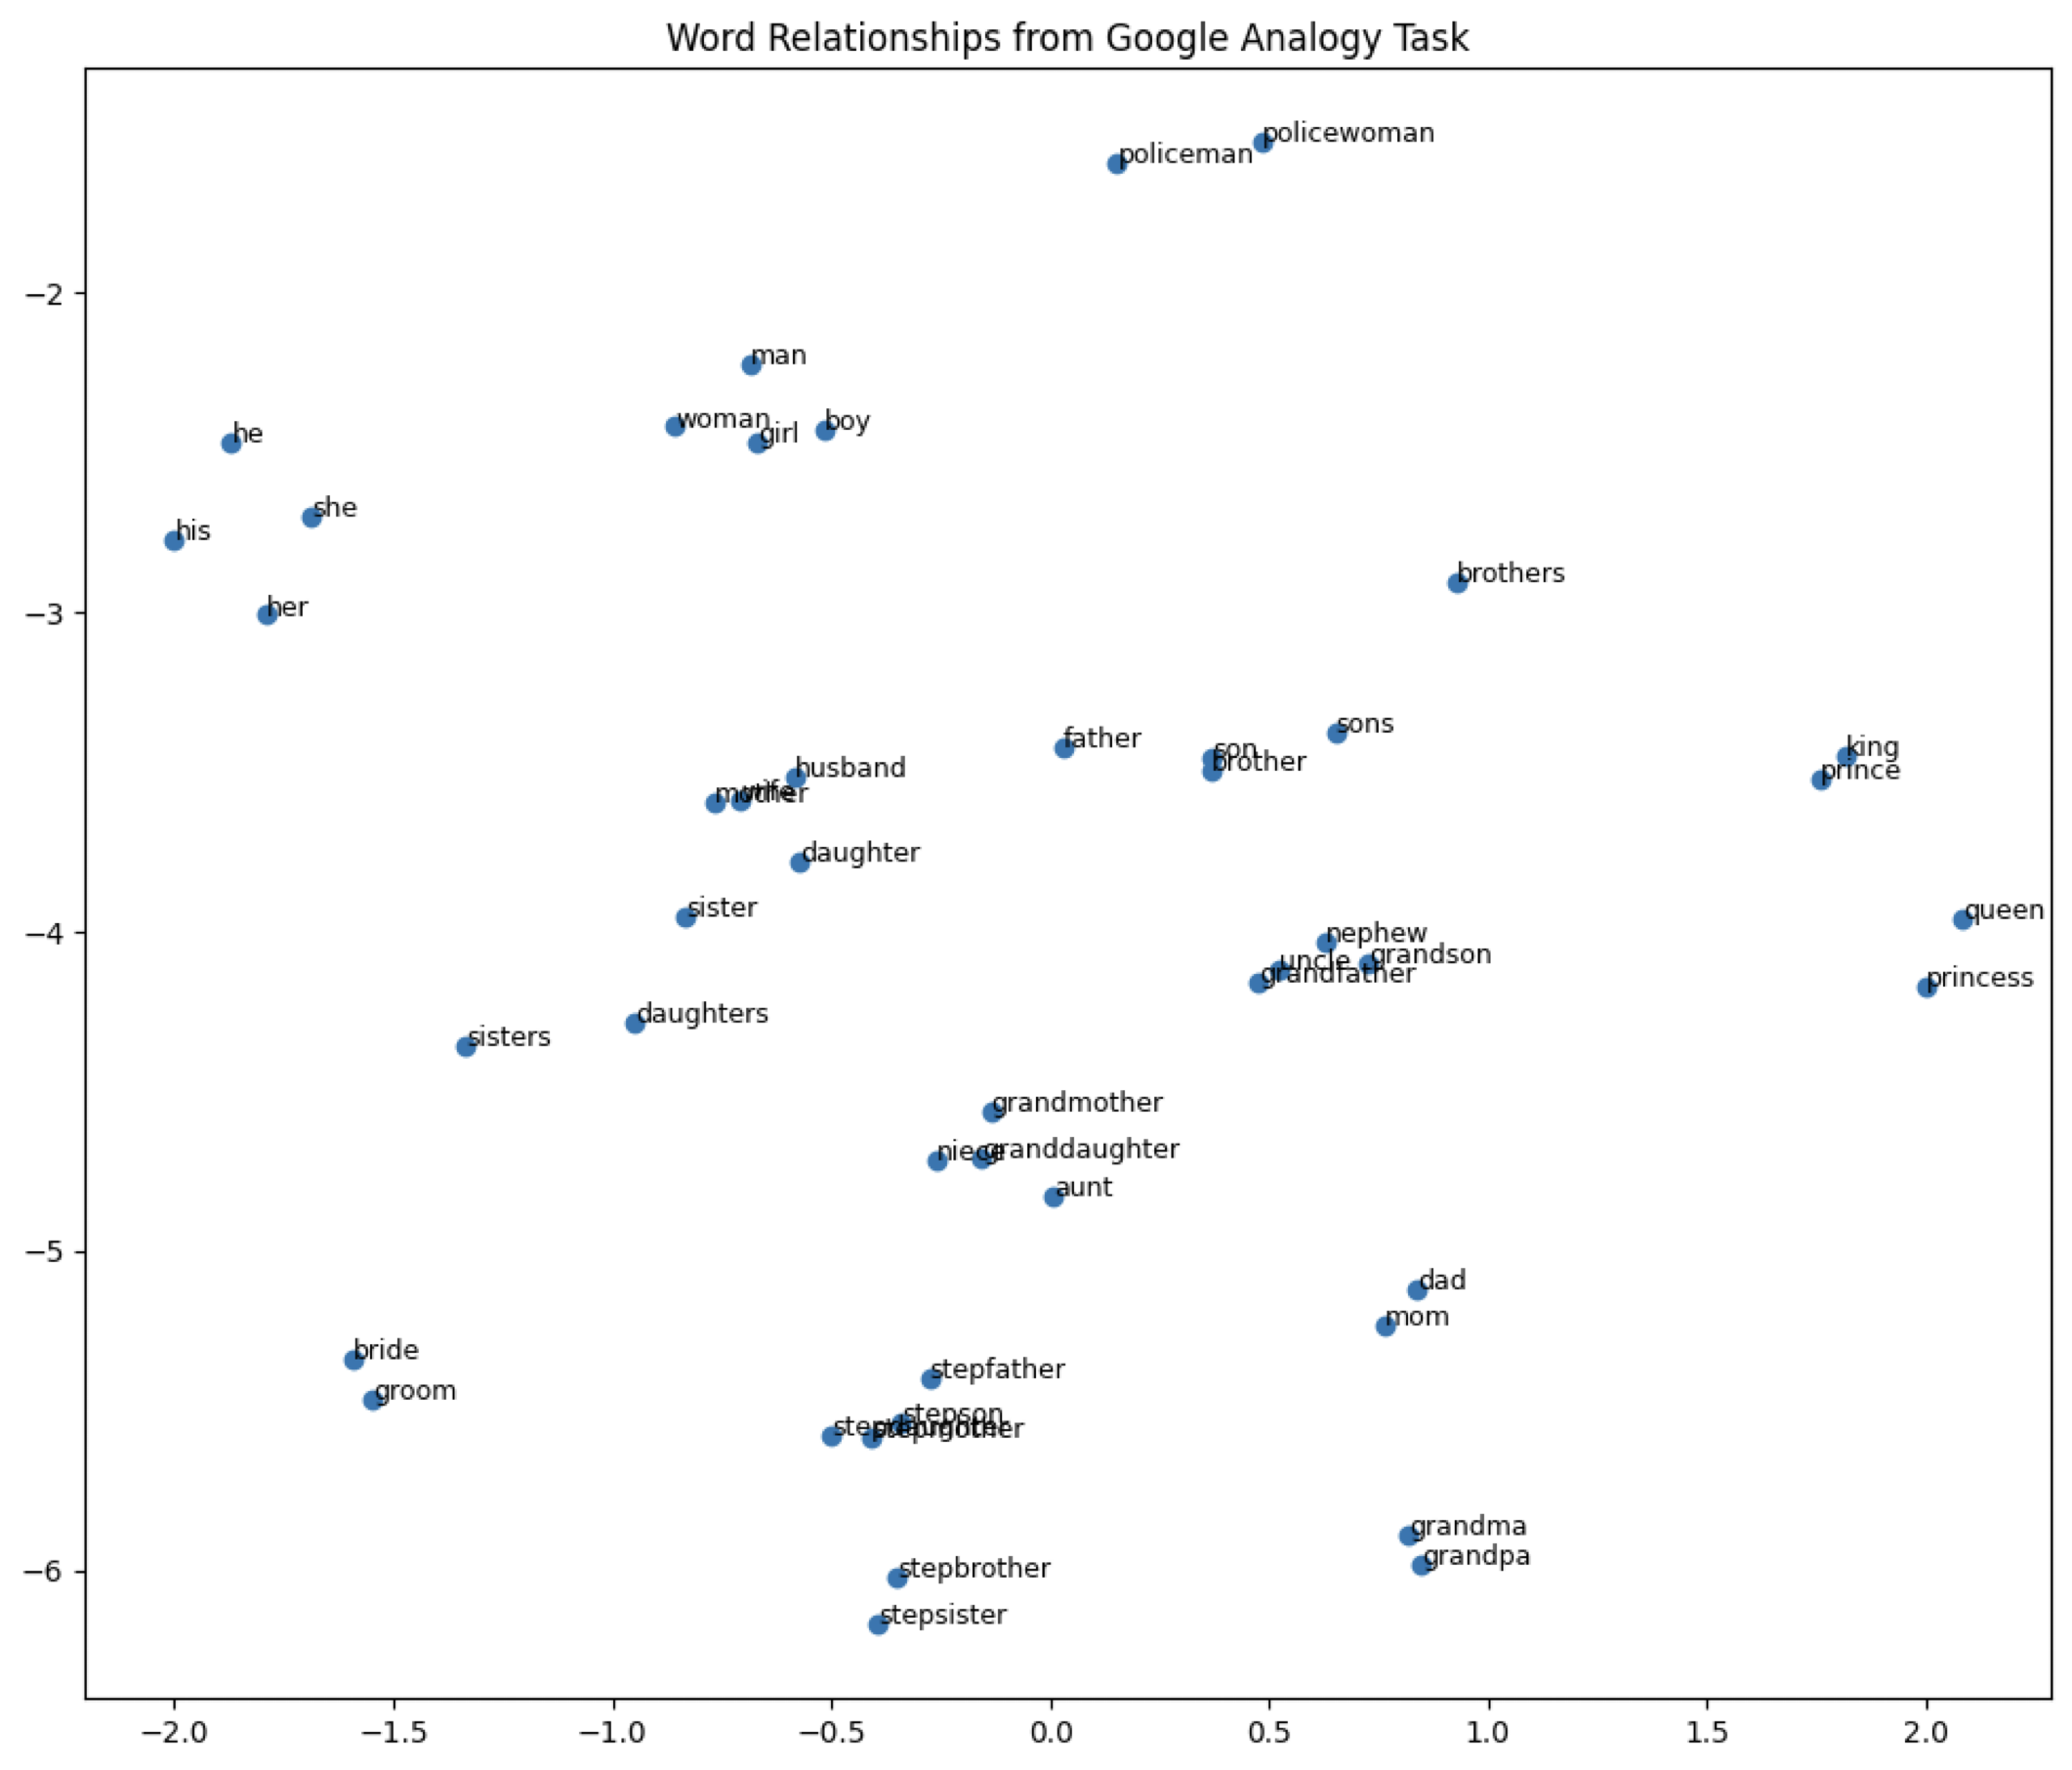
Word Embeddings 視覺化
Word embedding model: glove-wiki-gigaword-100
Dimension reduction: t-SNE
Dataset: Mikolov et al., 2013

Slide 18
Problems of Traditional Word Embeddings
Out-of-vocabulary problem
Model architecture for down-stream applications
Context-dependent representations

Slide 19
The Out-of-vocabulary Problem
Before training word embeddings, words are split by whitespaces for English corpora
Vocabulary
(假設字典的內容由a排到z)
apple
300-dimensional vector
...
jobs
300-dimensional vector
Word2vec
(Embeddings)
...
jobs
300-dimensional vector
...
QAQ
?
...
如果字沒有出現在字典中 (可能此字不存在於訓練資料)，那它就不會有對應的字向量

Slide 20
Sub-word Tokenization (Byte Pair Encoding)
Byte Pair Encoding (BPE)^{[3]} is a sub-word (子詞) tokenization technique used to handle rare words by breaking them into more frequent sub-word units.
Example sentence:
I printed Hello world.
Traditional word tokenization
Traditional with BPE
I
printed
Hello
world
I
prin
ted
Hell
o
world
分詞方法的決定是無監督式的
(細節預計於W5講授)
[3] Sennrich et al. "Neural Machine Translation of Rare Words with Subword Units." ACL 2016.

Slide 21
Sub-word Tokenization 的好處
With sub-word tokenization algorithms like BPE, we can handle representations for unknown words (or mis-spelled words).
In machine translation , the compound word issues between source and target languages can be alleviated.
State-of-the-art pre-trained language models (e.g., GPT-3, BERT) adopt sub-word tokenization algorithms before pre-training.

Slide 22
Problems of Traditional Word Embeddings
Out-of-vocabulary problem
Model architecture for down-stream applications
Context-dependent representations

Slide 23
The Pre-training then Fine-tuning Paradigm
Pre-training
Fine-tuning
在大量資料上進行訓練，通常是自監督式 (Self-Supervised Training)
在目標資料上進行訓練，通常是監督式 (Supervised Training)，也就是需要有標註的資料才能進行模型訓練

Slide 24
Contextual Word Representations (RNN)
open a bank account
on the river bank
the same word vector
Recurrent Neural Network
(Contextual Embedding)
Recurrent Neural Network
(Contextual Embedding)
open
a
bank
account
on
the
river
bank
How about bi-directional?

Slide 25
Contextual Word Representations (Transformer)
open a bank account
on the river bank
the same word vector
Self-attention
Self-attention
Transformer
(Contextual Embedding)
Transformer
(Contextual Embedding)
open
a
bank
account
on
the
river
bank

Slide 26
Model Training: Pre-training and Fine-Tuning
Step1: Pre-training (use large-scale corpora)
Model (e.g., Word2vec, BERT)
Open a [MASK] account
bank
Step2: Fine-Tuning (use datasets from target tasks)
Model (e.g., Word2vec + RNN; BERT + Classifier)
It was a good movie!
Positive
Devlin, Jacob, et al. "BERT: Pre-training of Deep Bidirectional Transformers for Language Understanding." NAACL 2019.

Slide 27
BERT: Bidirectional Encoder Representations from Transformers
Masked Language Modelling
Next Sentence Prediction
bank
binary classification
BERT
(Contextual Embedding)
BERT
(Contextual Embedding)
[CLS]
open
a
[MASK]
account
[SEP]
[CLS]
study
hard
[SEP]
please
[SEP]
Devlin, Jacob, et al. "BERT: Pre-training of Deep Bidirectional Transformers for Language Understanding." NAACL 2019.

Slide 28

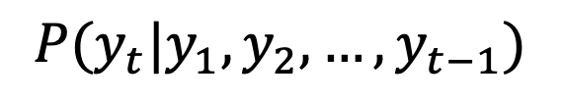
Generative Pre-Training (GPT)
(The next word)
y₈
$$P(y_{t}|y_{1},y_{2},…,y_{t−1})$$
Language Model
A model that assigns probabilities to upcoming words is called a language model.
The task involving predictions of upcoming words is language modeling.
y₁
y₂
y₃
y₄
y₅
y₆
y₇

Slide 29
Training Language Models to Follow Instructions with Human Feedback (ChatGPT)
Optimize
As close to human-written ground-truths as possible
Input Prompt
Supervised Fine-Tuning
Tell me who is Oppenheimer?
Language Model
(e.g., GPT-3.5)
Julius Robert Oppenheimer is …
Optimize
As high as possible
Input Prompt
Reinforcement Learning with Human Feedback (RLHF)
Tell me who is Oppenheimer?
Language Model
(e.g., GPT-3.5)
Score (Scalar)
Reward Model
(Trained from human preferences)
Ouyang, Long, et al. "Training language models to follow instructions with human feedback." Advances in neural information processing systems 35 (2022): 27730-27744.

Slide 30
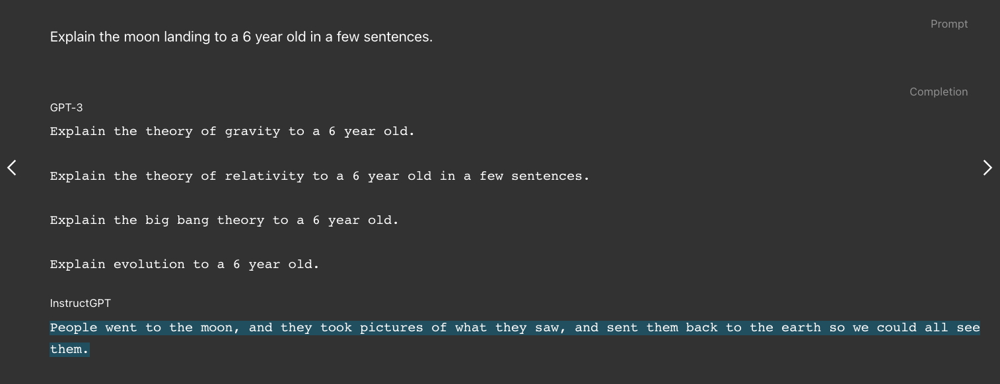
InstructGPT: the precursor of ChatGPT
Model size: 175B (same as GPT-3)
Figure source: https://openai.com/index/instruction-following/
Ouyang, Long, et al. “Training language models to follow instructions with human feedback.” NeurIPS 2022.

Slide 31
The Pre-training then Fine-tuning Paradigm
Pre-training
Fine-tuning
Instruction Fine-tuning
在目標資料上進行訓練，通常是監督式 (Supervised Training)，也就是需要有標註的資料才能進行模型訓練
讓模型的回答貼近人類
提升效能

Slide 32
Main Differences between BERT and ChatGPT
Model size:
BERT: 110 million
GPT-3.5: 175 billion (~=BERT*1590 times)
Training:
BERT: Masked-language modeling, Next-sentence Prediction
GPT-3.5: Language Modeling, Supervised Fine-Tuning, Reinforcement Learning by Human Feedback
NLP Tasks:
BERT: Natural Language Understanding (E.g., Classification)
GPT-3.5: Natural Language Generation (E.g., Machine Translation, Story Generation)

Slide 33
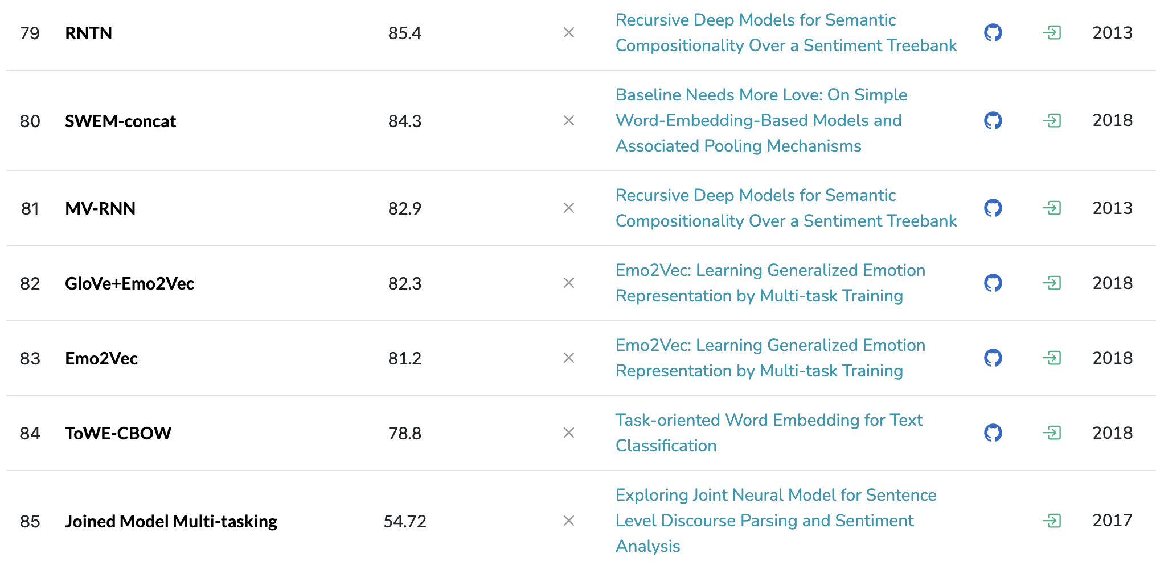
Why do we need DL in NLP?
https://paperswithcode.com/sota/sentiment-analysis-on-sst-2-binary
Liu, Qian, et al. "Task-oriented word embedding for text classification." Proceedings of the 27th international conference on computational linguistics. 2018.

Slide 34
History of Artificial Intelligence

Slide 35

Difference between AI, ML, and DL
Figure source: https://blogs.nvidia.com/blog/whats-difference-artificial-intelligence-machine-learning-deep-learning-ai/

Slide 36
圖靈測試 (Turing Test)
Proposed by Alan Turing in 1950
One of the earliest concepts of artificial intelligence.
🤖
🧑‍💻
🗒️
🗒️
?
🙎‍♂️

Slide 37
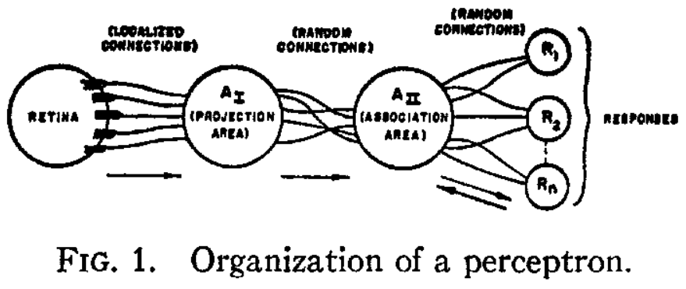
The first Perceptron (1958)
Rosenblatt, Frank. "The perceptron: a probabilistic model for information storage and organization in the brain." Psychological review 65.6 (1958): 386.

Slide 38
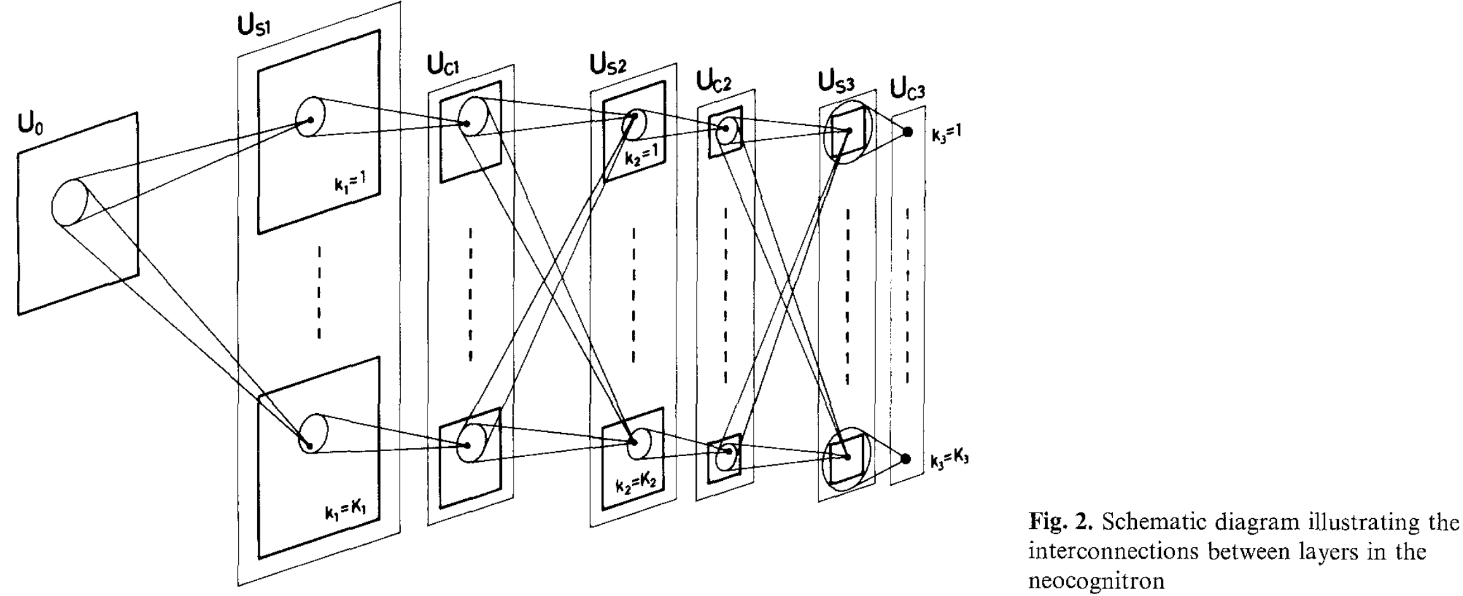
The First Convolutional Neural Networks: Neocognitron (1980)
Fukushima, Kunihiko. "Neocognitron: A self-organizing neural network model for a mechanism of pattern recognition unaffected by shift in position." Biological cybernetics 36.4 (1980): 193-202.

Slide 39
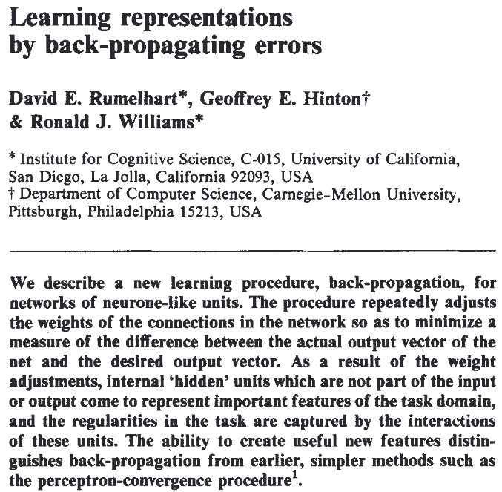
The Back-Propagation Algorithm (1986)
Forward pass
Output
Gold Ans
0.5
1.0
Backward pass
Rumelhart, David E., Geoffrey E. Hinton, and Ronald J. Williams. "Learning representations by back-propagating errors." nature 323.6088 (1986): 533-536.

Slide 40
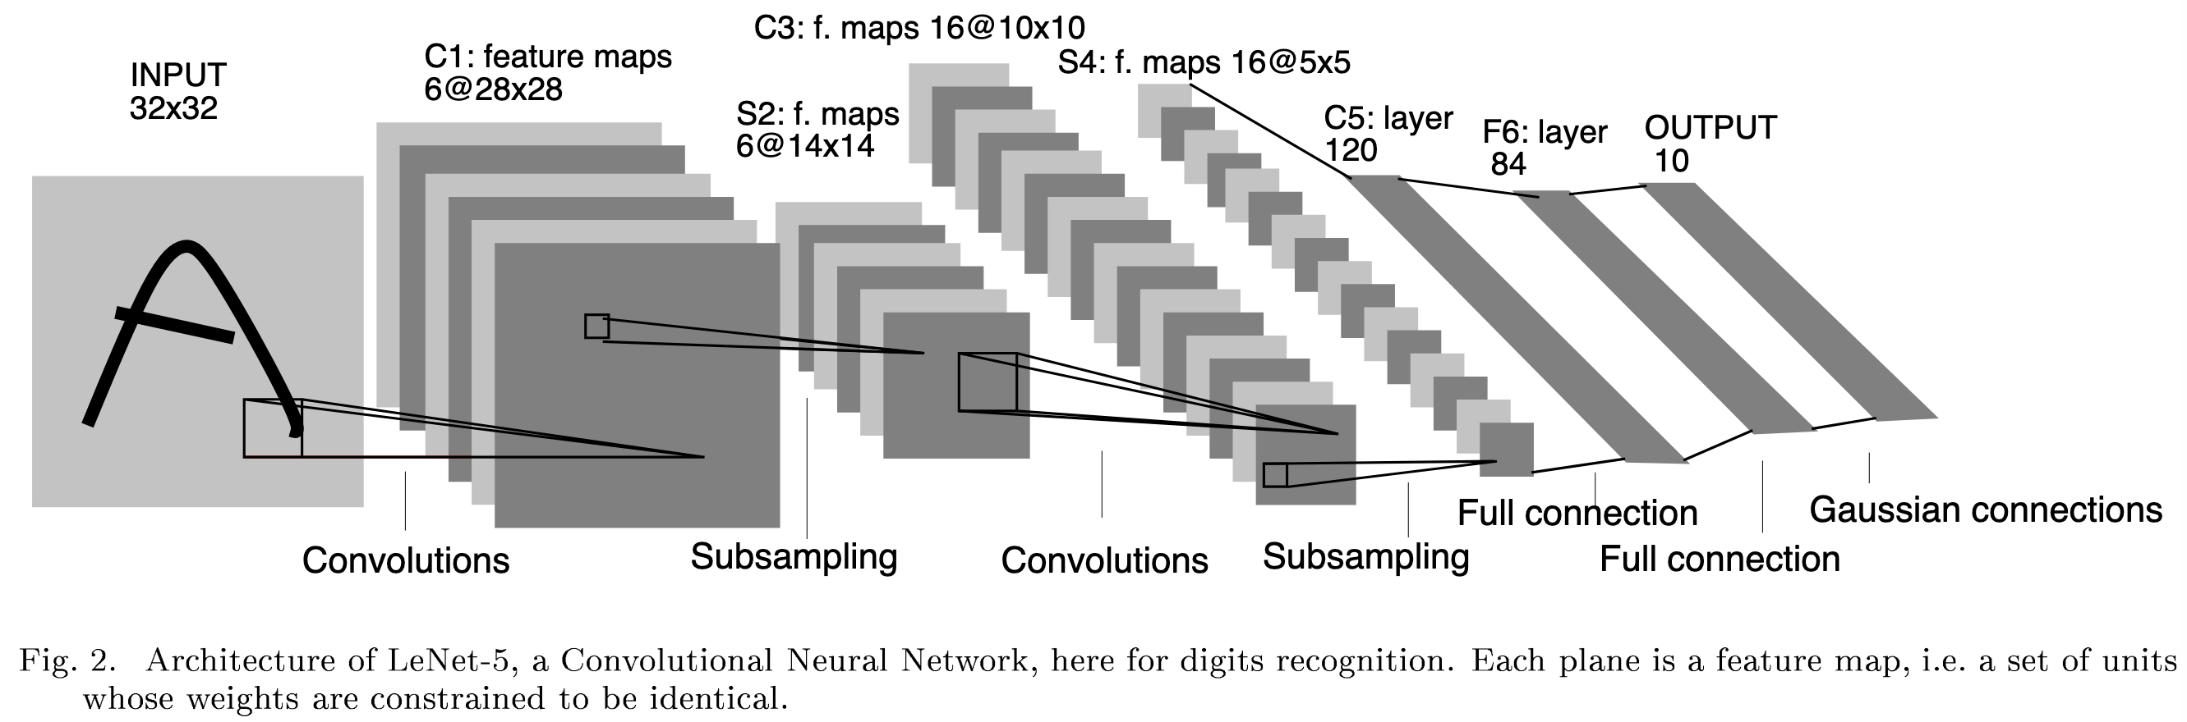
LeNet-5: Early Convolutional Neural Networks
LeCun, Y., Bottou, L., Bengio, Y., & Haffner, P. (1998). Gradient-based learning applied to document recognition. Proceedings of the IEEE, 86(11), 2278-2324.

Slide 41
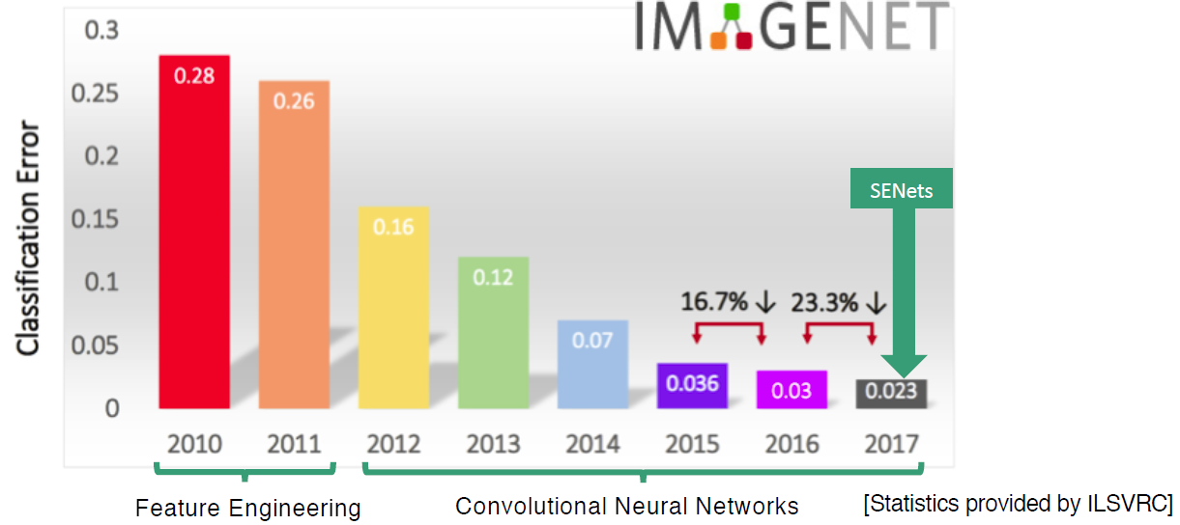
ImageNet Competition
Complete name: ImageNet Large Scale Visual Recognition Challenge (ILSVRC)
AlexNet
Figure source: https://www.kaggle.com/discussions/getting-started/149448

Slide 42
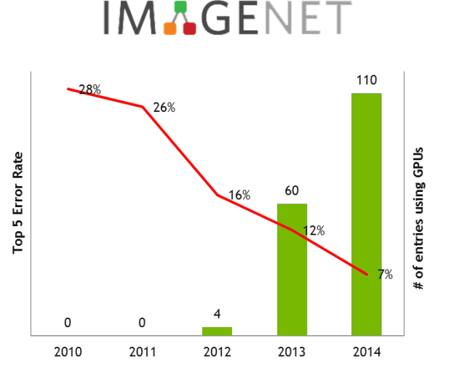
Growing Trend of GPU Usage during the ImageNet Competition
Figure source: https://developer.nvidia.com/blog/nvidia-ibm-cloud-support-imagenet-large-scale-visual-recognition-challenge/

Slide 43
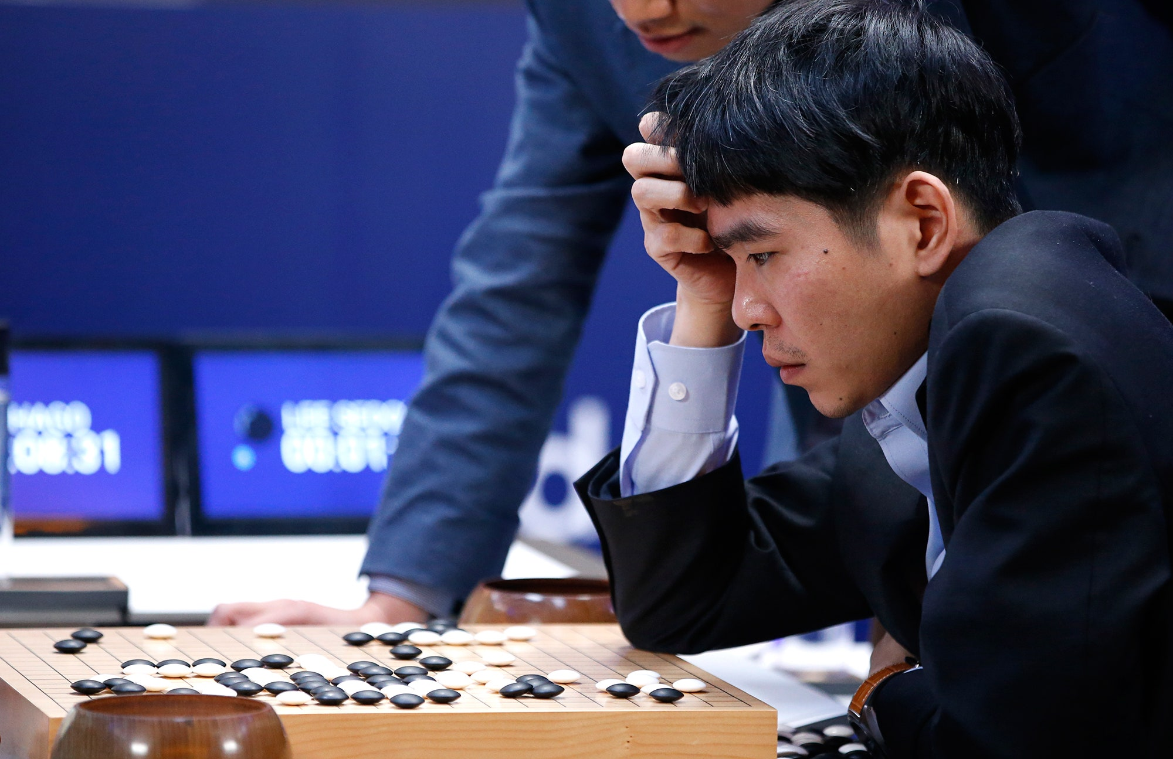
AlphaGo vs. Lee Sedol (2016)
Paper: Silver, D., Huang, A., Maddison, C. J., Guez, A., Sifre, L., Van Den Driessche, G., ... & Hassabis, D. (2016). Mastering the game of Go with deep neural networks and tree search. nature, 529(7587), 484-489.
Figure source: https://www.newyorker.com/tech/annals-of-technology/alphago-lee-sedol-and-the-reassuring-future-of-humans-and-machines

Slide 44
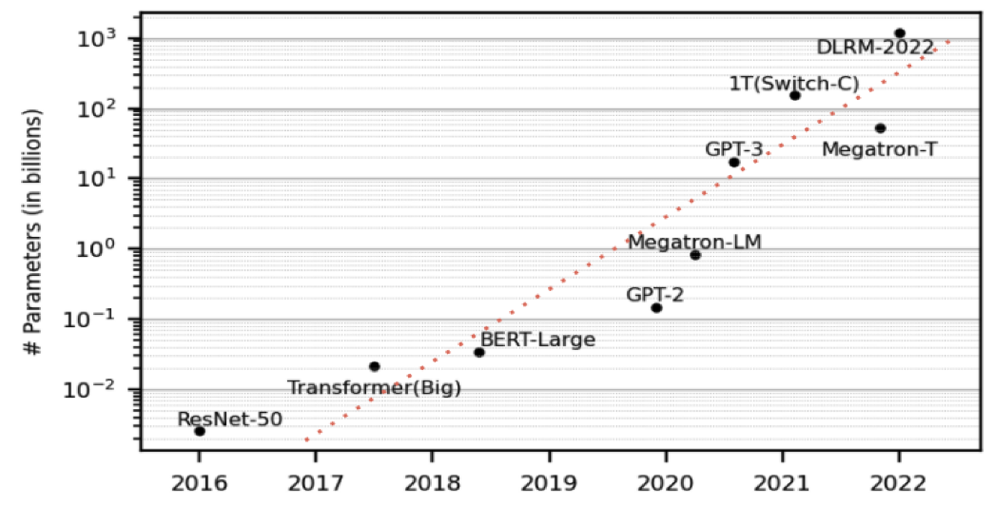
Growing Sizes of Deep Learning Models
Wu, Z., Dai, L. Y., Novick, A., Glick, M., Zhu, Z., Rumley, S., ... & Bergman, K. (2023). Peta-scale embedded photonics architecture for distributed deep learning applications. Journal of Lightwave Technology, 41(12), 3737-3749.

Slide 45
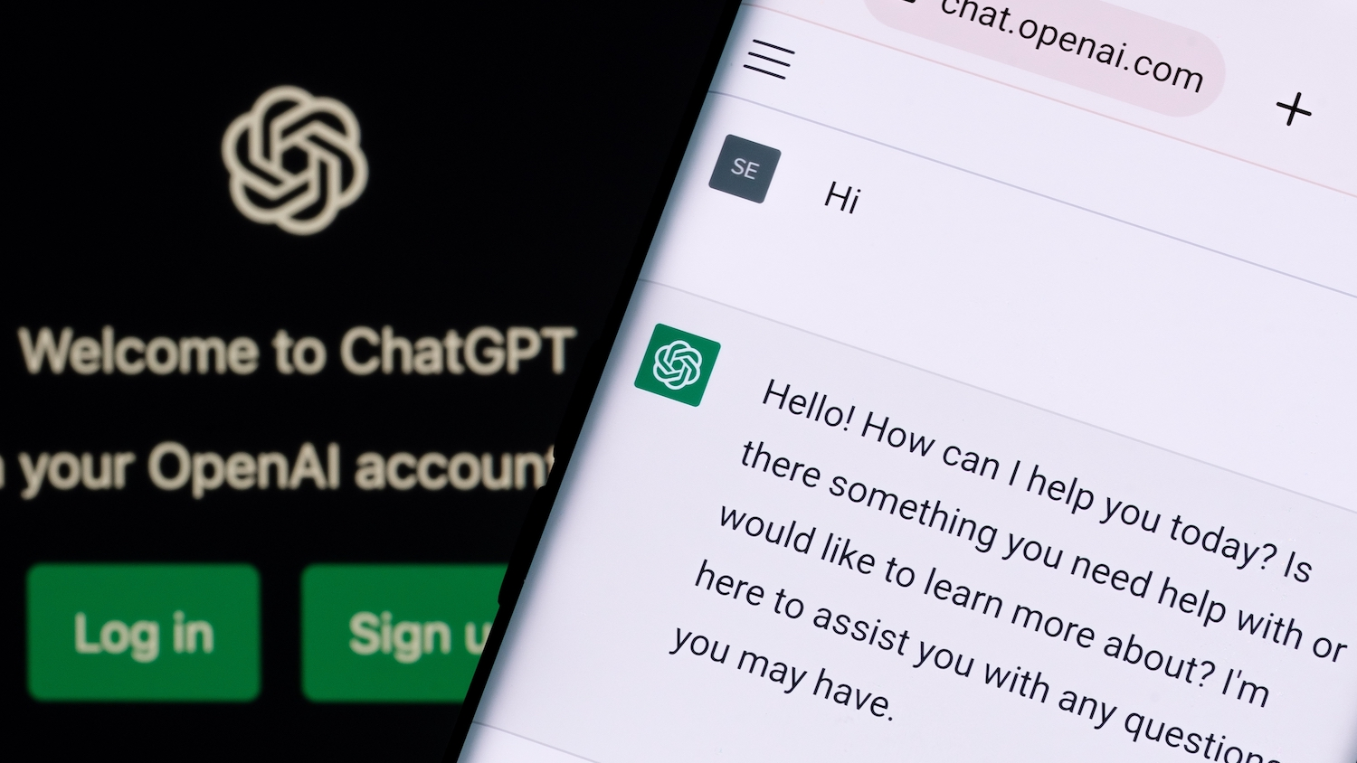
The Revolution of ChatGPT
ChatGPT came out in November, 2022.
Figure source: https://poole.ncsu.edu/thought-leadership/article/lets-chat-about-chatgpt/
https://openai.com/index/chatgpt/

Slide 46
我們這學期要學什麼？

Slide 47
自然語言處理基本功 (如何表達字詞)
Week 1 – Week 3
自然語言處理介紹
統計語言模型與基本詞向量方法
詞嵌入模型
like
🖥️
?
apple

Slide 48

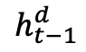
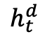
自然語言處理基本功 (序列模型)
Week 4 – Week 5
遞迴神經網路 / PyTorch Tutorial
注意力機制以及 Sub-word 分詞法
Context vector
…
$$h_{t−1}^{d}$$
$$h_{t}^{d}$$
Encoder time steps
Decoder time steps

Slide 49



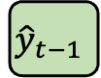
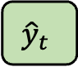
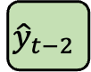
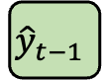
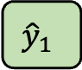
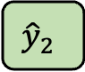
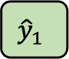
進階自然語言處理
Week 6 – Week 11
自注意力機制以及文字生成策略
BERT 與它的好夥伴
HuggingFace 函式庫實作教學 (1)
GPT-3, InstructGPT, RLHF, DeepSeek
PPO, GRPO
HuggingFace 函式庫實作教學 (2)
Output sequence
$${\hat{y}}_{1}$$
$${\hat{y}}_{2}$$
……
$${\hat{y}}_{t−1}$$
$${\hat{y}}_{t}$$
Decoder
_
$${\hat{y}}_{1}$$
……
$${\hat{y}}_{t−2}$$
$${\hat{y}}_{t−1}$$
(Start)

Slide 50
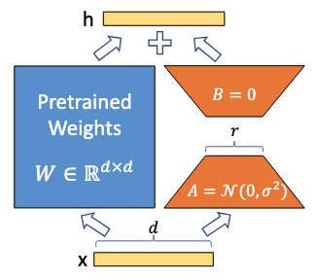
自然語言處理應用
Week 12 – Week 14
如何訓練大模型？輕量化微調方法
檢索式生成方法
Retrieval-augmented Generation (RAG)
檢索式生成方法實作教學
(Figure from the LoRA paper)
Hu, Edward J., et al. "LoRA: Low-Rank Adaptation of Large Language Models." ICLR 2022.

Slide 51
Syllabus
Week | Topic | Note
1 | 自然語言處理介紹以及本課程綱要
2 | 統計語言模型與基本詞向量方法
3 | 詞嵌入模型 | HW1
4 | 遞迴神經網路 / PyTorch Tutorial
5 | 注意力機制以及 Sub-word 分詞法 | HW2
6 | 自注意力機制以及文字生成策略
7 | BERT 與它的好夥伴
8 | 期中考 | HW3
9 | HuggingFace 函式庫實作教學 (1)
10 | 現代自然語言處理：GPT-3, InstructGPT, RLHF, DeepSeek
11 | HuggingFace 函式庫實作教學 (2) | HW4
12 | 如何訓練大模型？輕量化微調方法
13 | 檢索式生成方法 | HW5
14 | 檢索式生成方法實作教學
15 | 小組實作成果報告 (1)
16 | 小組實作成果報告 (2)
Tutorial
Exam
Report

Slide 52
Scoring
Assignments (5 times): 40%
Quizzes: 1% x 10 times
Mid-term Exam: 20%
Term Project: 30%

Slide 53
About the Quizzes
不定時，代表出席分數，若多於10次即僅採計10次
與當週的上課內容有關
Feel free to search the Internet

Slide 54
About the Assignments
與當週的上課內容有關
作業一定都會有範例程式碼 (Sample Code)

Slide 55
Final Project 是什麼？
Final Project 是一種完整的訓練
你將自行從頭到尾做完一個題目，包含：
資料前處理 (Data Pre-processing)
模型訓練 (Model Training)
模型評估 (Evaluations) -->了解問題並改進模型
每組人數待修課同學總數訂定，原則上1-3人/組

Slide 56
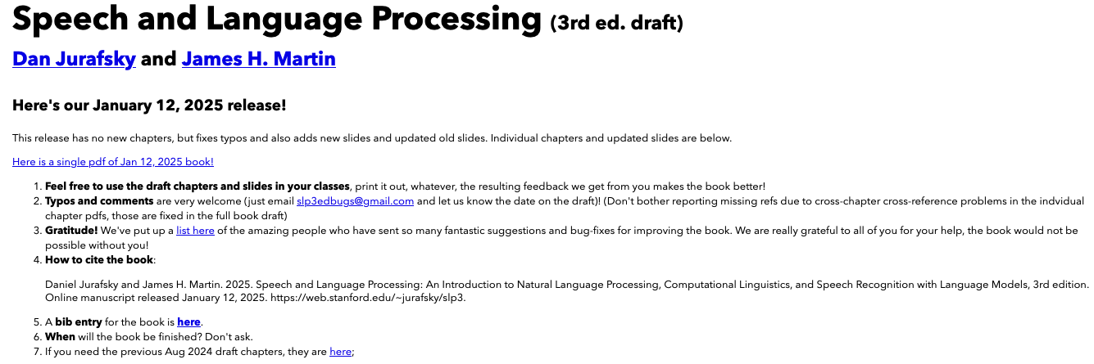
Textbook
Speech and Language Processing (3rd ed. draft) Dan Jurafsky and James H. Martin.
Free Online book (Jan 2025 version): https://web.stanford.edu/~jurafsky/slp3/ed3book_Jan25.pdf

Slide 57
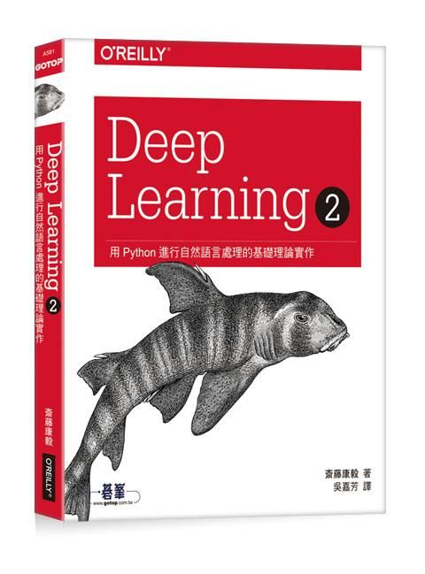
Reference book
Deep Learning 2｜用Python進行自然語言處理的基礎理論實作，歐萊禮 (ISBN: 9789865020675)
GitHub of this book:
https://github.com/oreilly-japan/deep-learning-from-scratch-2

Slide 58
生成式AI融合教學
以組為單位
ChatGPT Plus
Google Colab Pro 雲端運算付費服務
OpenAI API 呼叫大型語言模型進行生成式服務

Slide 59
Contact Information
Instructor: 林英嘉
✉️ yjlin@cgu.edu.tw
🕘 Office Hour: 歡迎來信預約，一定沒問題
寄信前請在主旨加註記 [自然語言處理]

Slide 60
Thank you!
Instructor: 林英嘉
✉️ yjlin@cgu.edu.tw

